Slide 1
Task 3

Slide 2
Report
The website http://testasp.vulnweb.com/ is vulnerable to a Reflected Cross Site Scripting.
As per OWASP's definition: "Cross-Site Scripting (XSS) attacks are a type of injection, in which malicious scripts are injected into otherwise benign and trusted websites.
This vulnerability happens when there is improper architecture or design of the website, specifically the library or framework used for it.

Slide 3
Steps to Reproduce
I used BurpSuite to intercept as proxy and test the vulnerabilities and OWASP to detect vulnerabilities and get a suitable payload.
Visit the website and go to its search tab. Enter any appropriate input and intercept it using BurpSuite.
After intercepting send it to repeater and try different XSS payloads into the input field, or use OWASP and get the appropriate payload like I did.

Slide 4
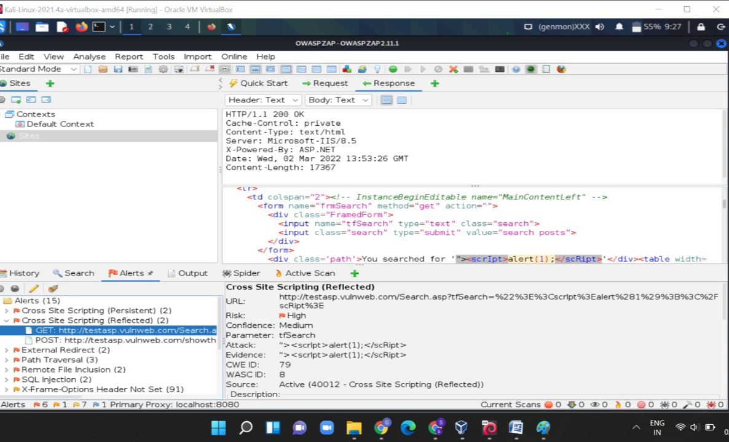

Slide 5
3. As we can see in the previous screenshot the payload : “><script>alert(1);</script>
Was used and the following output was shown.

Slide 6
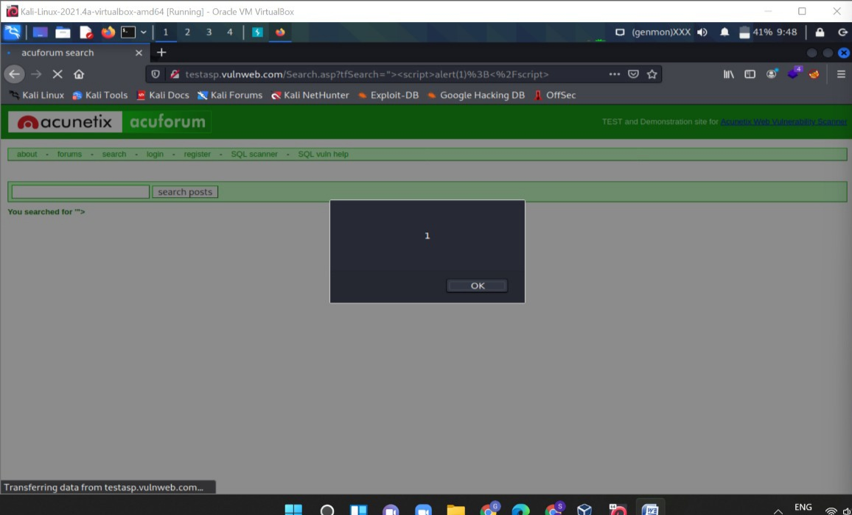

Slide 7
Impact
By exploiting a cross-site scripting vulnerability, an attacker can impersonate a legitimate user and take over their account.
If the victim user has administrative privileges, it might lead to severe damage such as modifications in code or databases to further weaken the security of the web application, depending on the rights of the account and the web application.
Following can be the possible impacts –
1. Account Hijacking
2. Data Leakage
3. Credential Theft

Slide 8
Solution
Using a vetted library or framework that does not allow this weakness to occur or provides constructs will make this weakness easier to avoid.

